Slide 1
Cpp development
Lecture 7

Slide 2
Schedule
Multiprocessing
Threads
Multithreading
Windows thread management

Slide 3
Multiprocessing

Slide 4

Uniprogramming

Slide 5
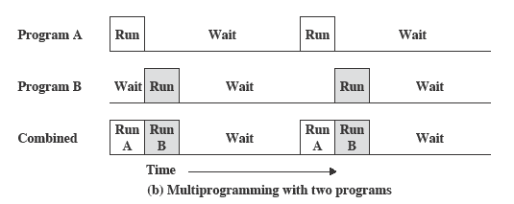
Multiprogramming

Slide 6
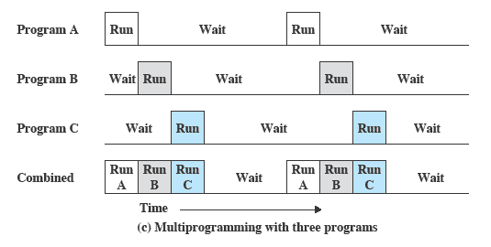
Multiprogramming

Slide 7
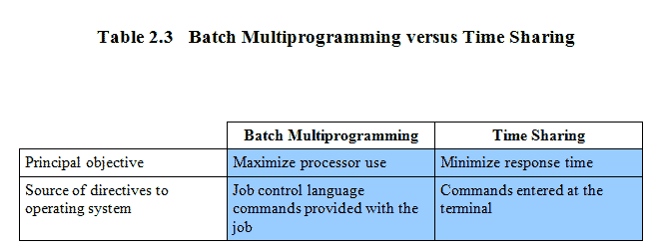
Batch multiprogramming vs time sharing

Slide 8
Process
A program in execution
An instance of a program running on a computer
The entity that can be assigned to and executed on a processor

Slide 9
Process
Consists of three components
An executable program
Associated data needed by the program
Execution context of the program
All information the operating system needs to manage the process

Slide 10
Scheduling and resource management
Fairness
Give equal and fair access to resources
Differential responsiveness
Discriminate among different classes of jobs
Efficiency
Maximize throughput, minimize response time, and accommodate as many uses as possible

Slide 11
Modern OS
Microkernel architecture
Assigns only a few essential functions to the kernel
Address spaces
Interprocess communication (IPC)
Basic scheduling

Slide 12
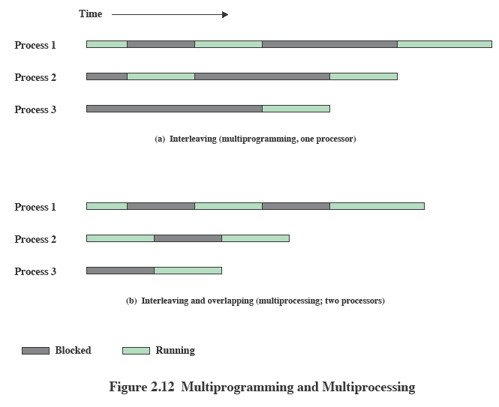
Multiprogramming and multiprocessing

Slide 13
Trace of the process
The behavior of an individual process is shown by listing the sequence of instructions that are executed
This list is called a Trace
Dispatcher is a small program which switches the processor from one process to another

Slide 14
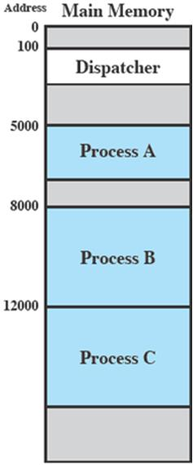
Process execution
Consider three processes being executed
All are in memory (plus the dispatcher)
Lets ignore virtual memory for this.

Slide 15
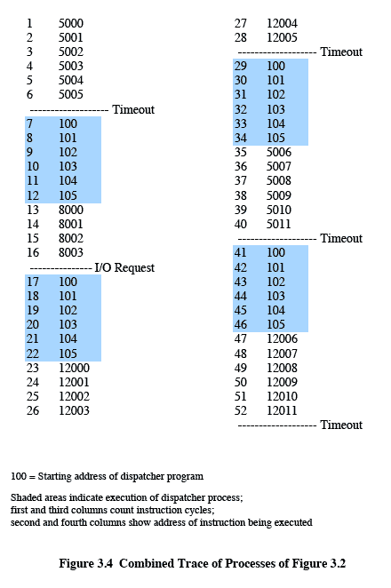
Trace from processor point of view
Timeout

Slide 16
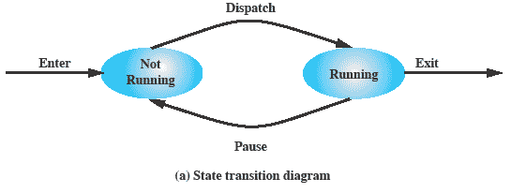
Two state process model
Process may be in one of two states
Running
Not-running

Slide 17
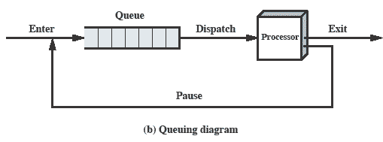
Queuing Diagram

Slide 18
Process creation
The OS builds a data structure to manage the process
Traditionally, the OS created all processes
But it can be useful to let a running process create another
This action is called process spawning
Parent Process is the original, creating, process
Child Process is the new process

Slide 19
Process termination
There must be some way that a process can indicate completion.
This indication may be:
A HALT instruction generating an interrupt alert to the OS.
A user action (e.g. log off, quitting an application)
A fault or error
Parent process terminating

Slide 20
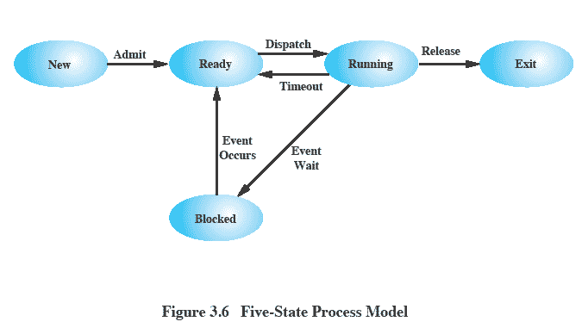
Five-state process model

Slide 21
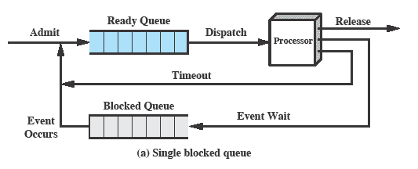
Using two queues

Slide 22
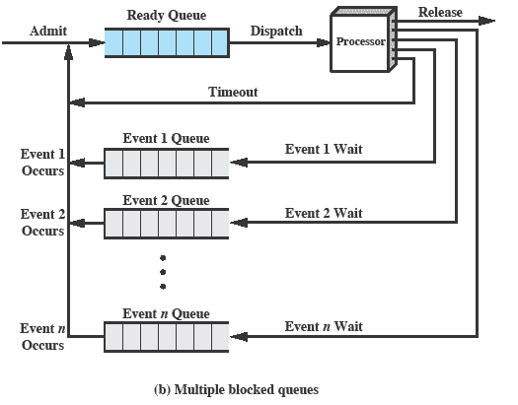
Multiple blocked queues

Slide 23
Suspended processes
Processor is faster than I/O so all processes could be waiting for I/O
Swap these processes to disk to free up more memory and use processor on more processes
Blocked state becomes suspend state when swapped to disk
Two new states
Blocked/Suspend
Ready/Suspend

Slide 24
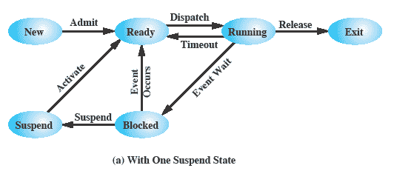
One suspend state

Slide 25
Threads

Slide 26
Processes and threads
The unit of dispatching is referred to as a thread or lightweight process
The unit of resource ownership is referred to as a process or task

Slide 27
Single thread approaches
MS-DOS supports a single user process and a single thread.
Some UNIX, support multiple user processes but only support one thread per process

Slide 28
Multithreading
Java run-time environment is a single process with multiple threads
Multiple processes and threads are found in Windows, Solaris, and many modern versions of UNIX

Slide 29
Activities similar to processes
Threads have execution states and may synchronize with one another.
Similar to processes
We look at these two aspects of thread functionality in turn.
States
Synchronisation

Slide 30
Thread execution states
States associated with a change in thread state
Spawn (another thread)
Block
Issue: will blocking a thread block other, or all, threads
Unblock
Finish (thread)
Deallocate register context and stacks

Slide 31
Remote procedure call
Consider:
A program that performs two remote procedure calls (RPCs)
to two different hosts
to obtain a combined result.

Slide 32
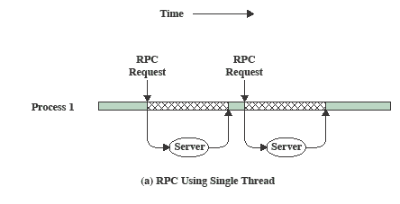
RPC single thread

Slide 33
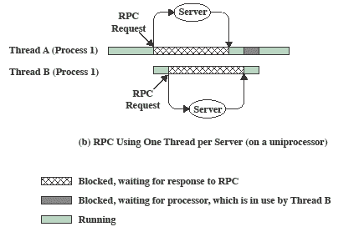
RPC multithread

Slide 34
How to spawn thread
#include <iostream>
#include <thread>
void function() { // some function
}
int main()
{
std::thread aThread(function);
return 0;
}

Slide 35
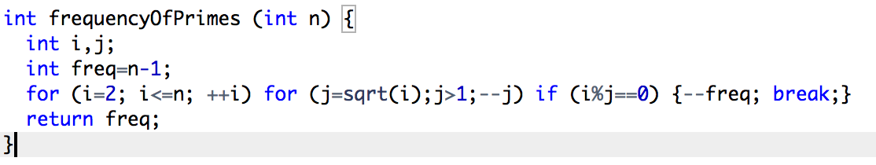
Task
Write a program that is calculating the time for calculating number of prime numbers below 100 000, 5 times.
Get values for single thread execution and multithread execution.
Use int clock() for getting ticks of the processors since start of program. Use CLOCKS_PER_SEC and some simple math for getting interval of seconds.

Slide 36
Problems ?

Slide 37
Thread synchronization
When the main thread needs to wait for another thread to end, you use aThread.join().
Main thread
Join threads
return
Thread 1
Thread 2
Thread n

Slide 38
Now lets try the last task

Slide 39
Problems in multithreading programming

Slide 40
Deadlocks

Slide 41
Deadlock
A set of processes is deadlocked when each process in the set is blocked awaiting an event that can only be triggered by another blocked process in the set
Typically involves processes competing for the same set of resources
No efficient solution

Slide 42
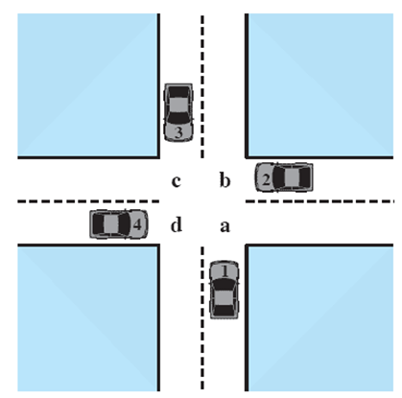
Deadlock

Slide 43
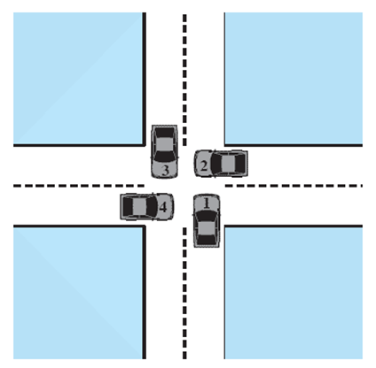
Deadlock

Slide 44
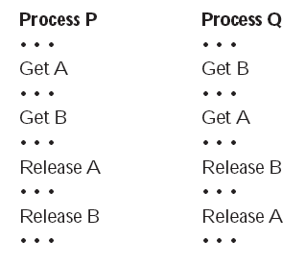
Thread P and Q (Deadlock is happening)

Slide 45
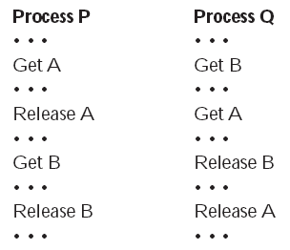
Thread P and Q (Deadlock is not happening)

Slide 46
Deadlock conditions
Mutual exclusion
Only one thread may use a resource(variable) at a time
Hold-and-wait
A thread may hold allocated resources while awaiting assignment of others
No pre-emption
No resource can be forcibly removed form a thread holding it

Slide 47
Dealing with deadlock
Three general approaches exist for dealing with deadlock.
Prevent deadlock
Avoid deadlock
Detect Deadlock

Slide 48
Deadlock Prevention
Design a system in such a way that the possibility of deadlock is excluded.
Two main methods
Indirect – prevent all three of the necessary conditions occurring at once
Direct – prevent circular waits

Slide 49
Deadlock avoidance
A decision is made dynamically whether the current resource allocation request will, if granted, potentially lead to a deadlock
Requires knowledge of future process requests

Slide 50
Deadlock avoidance
Process Initiation Denial
Do not start a thread if its demands might lead to deadlock
Resource Allocation Denial
Do not grant an incremental resource request to a thread if this allocation might lead to deadlock

Slide 51
Deadlock detection
Deadlock prevention strategies are very conservative;
limit access to resources and impose restrictions on processes.
Deadlock detection strategies do the opposite
Resource requests are granted whenever possible.
Regularly check for deadlock

Slide 52
Mutex

Slide 53
Mutex
Suppose two or more threads require access to a single nonsharable resource, such as a printer.
During the course of execution, each process will be sending commands to the I/O device, receiving status information, sending data, and/or receiving data.
The code that needs the critical resource is called critical section

Slide 54
Requirements for mutual exclusion
Only one process at a time is allowed in the critical section for a resource
A process that halts in its noncritical section must do so without interfering with other processes
No deadlock or starvation

Slide 55
Requirements for mutual exclusion
A process must not be delayed access to a critical section when there is no other process using it
No assumptions are made about relative process speeds or number of processes
A process remains inside its critical section for a finite time only

Slide 56
Implementation of Cpp Mutex
#include <mutex>
std::mutex mtx;
void function()
{
mtx.lock();
//Execute the critical section
mtx.unlock();
}

Slide 57
Starvation
This is the process when a process/thread is needing a resource which is not available.

Slide 58
Spinlock
This is the process when multiple threads are waiting for entering the critical section. The one that enters is not clearly defined by the logic.

Slide 59
Daily task
100 people must exit a room with one exit. Only one of them can exit at a time and needs 200 ms to exit. Represent the people by spawning threads and represent the door as a critical resource

